Slide 1
DECISION TREES
Aum Sri Sairam

Slide 2
What type of ML task is performed by Decision Trees?
Explain the working procedure of a DT classifier with an example.
Define a decision tree classifier.
What are the components of a decision tree and What are decision rules?
What is the principle/technique behind the functionality of a decision tree classifier explain the technique mathematically.
Define a split point.
Define Data Partition
Define purity in the context of a region/space.
How to find the split point in case of a categorical attribute?
What is the stopping condition for splitting?
QUESTIONS

Slide 3
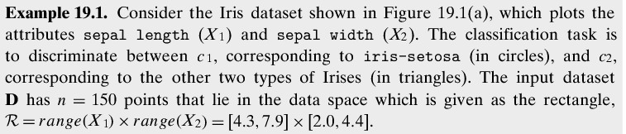
Problem:

Slide 4
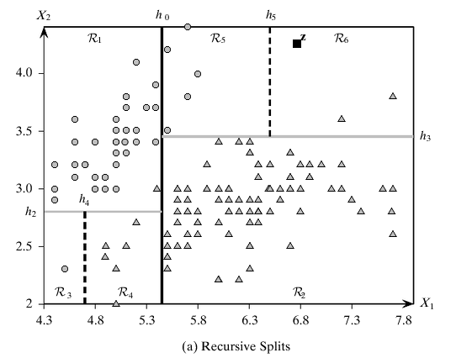

Slide 5
A decision tree consists of internal nodes that represent the decisions corresponding to the hyperplanes or split points (i.e., which half-space a given point lies in), and leaf nodes that represent regions or partitions of the data space, which are labeled with the majority class.
A region is characterized by the subset of data points that lie in that region.

Slide 6
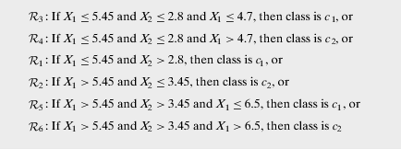

Slide 7
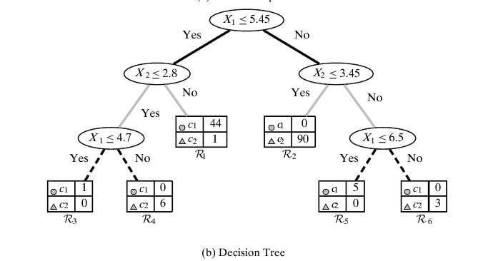

Slide 8
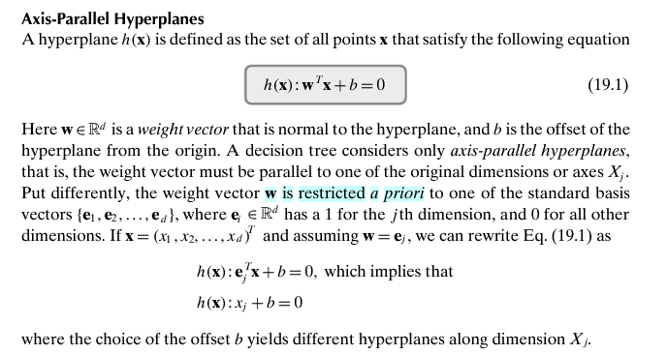

Slide 9
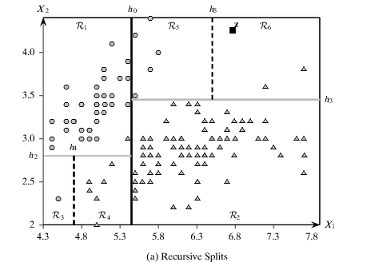
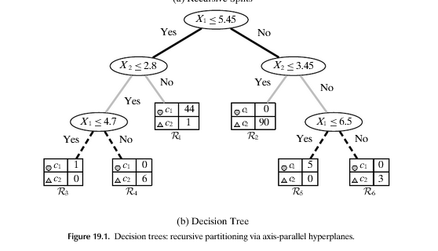

Slide 10
Keywords
Split Point
Data Partition
Purity

Slide 11
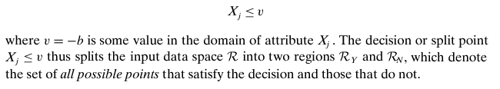
Split Point

Slide 12
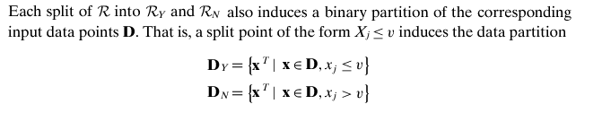
Data Partition

Slide 13

Purity

Slide 14
Categorical Variables

Slide 15
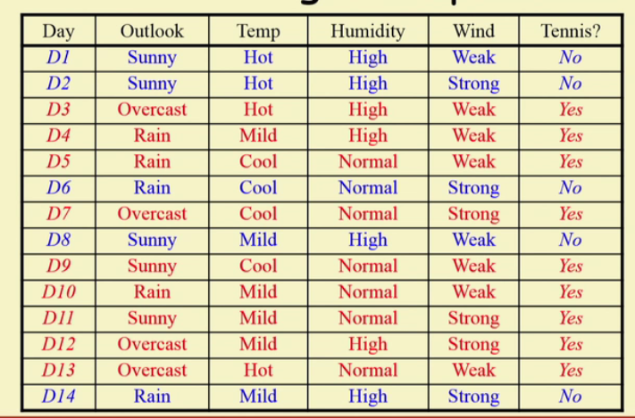
TRAINING EXAMPLE:

Slide 16
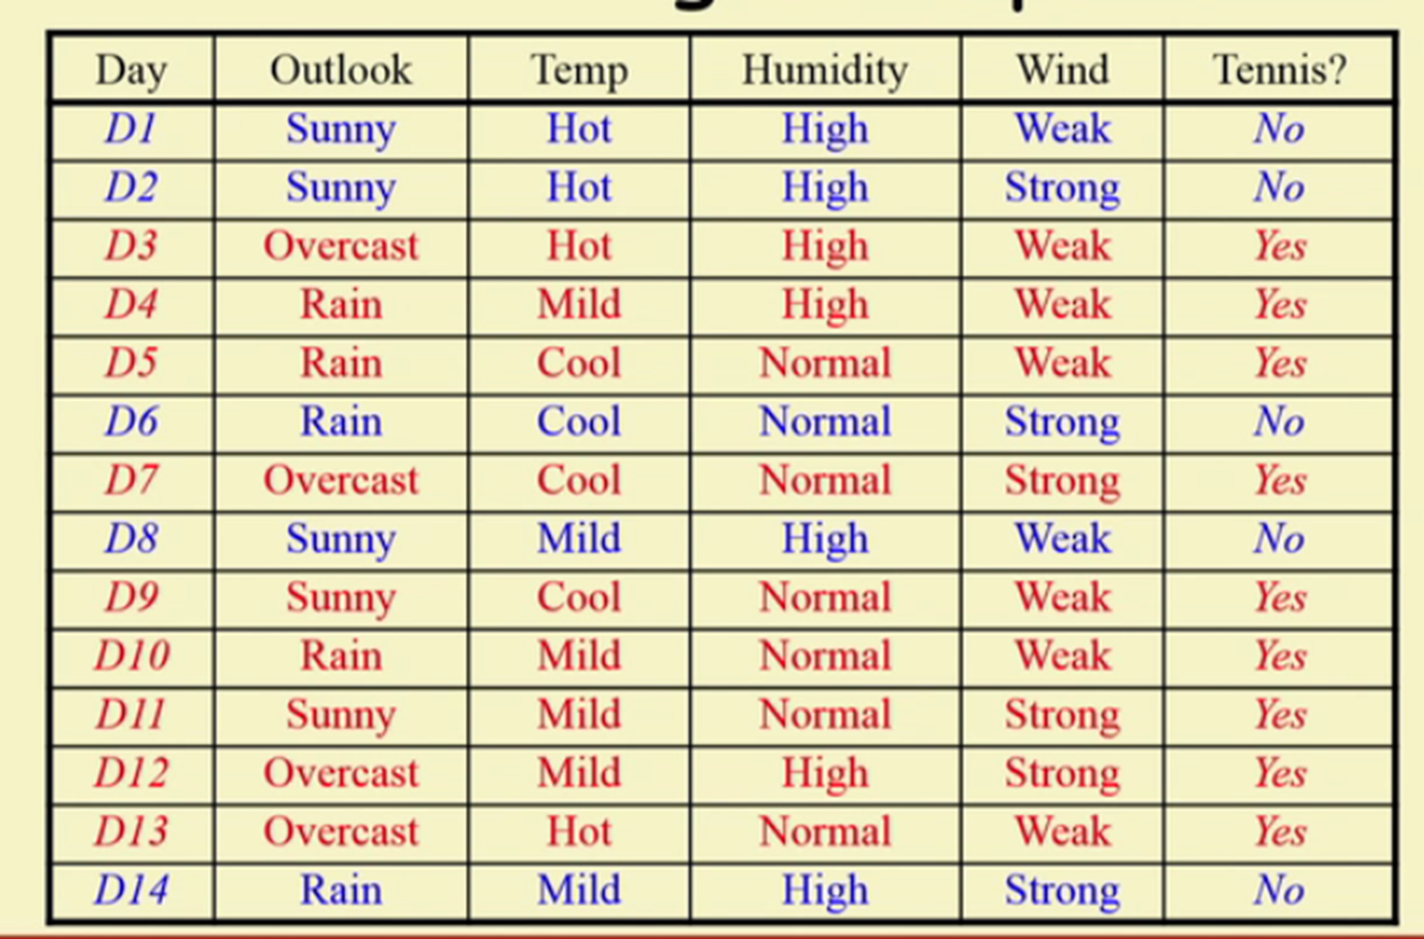
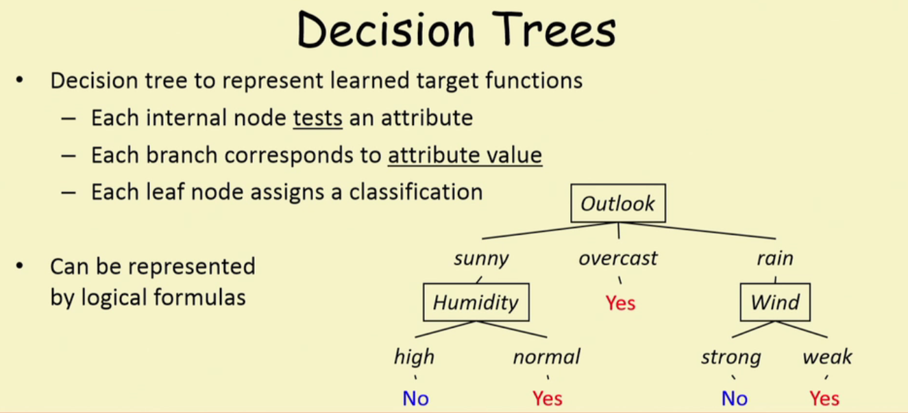
DATA MATRIX-DECISION TREE

Slide 17
Jai Sairam

Slide 18
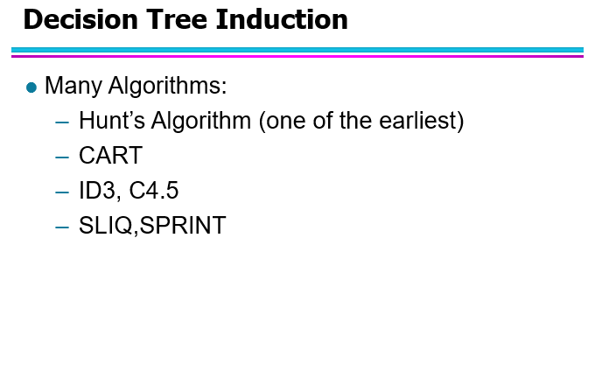
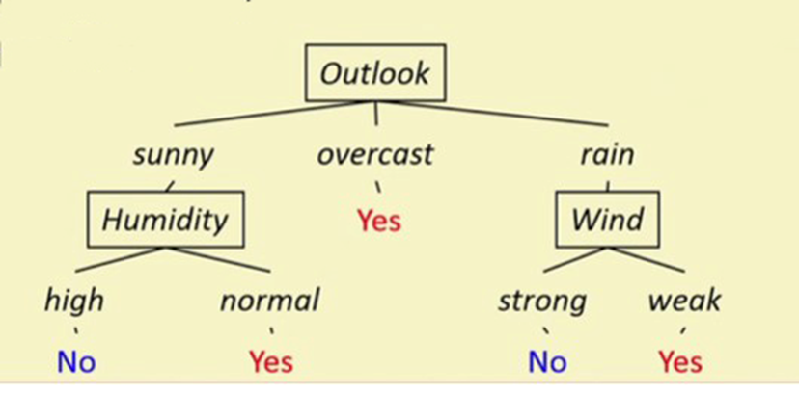

Slide 19
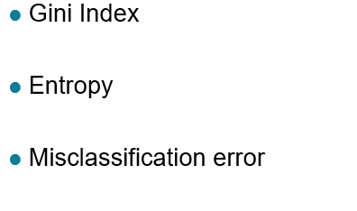
Impurity Measures of Nodes:

Slide 20
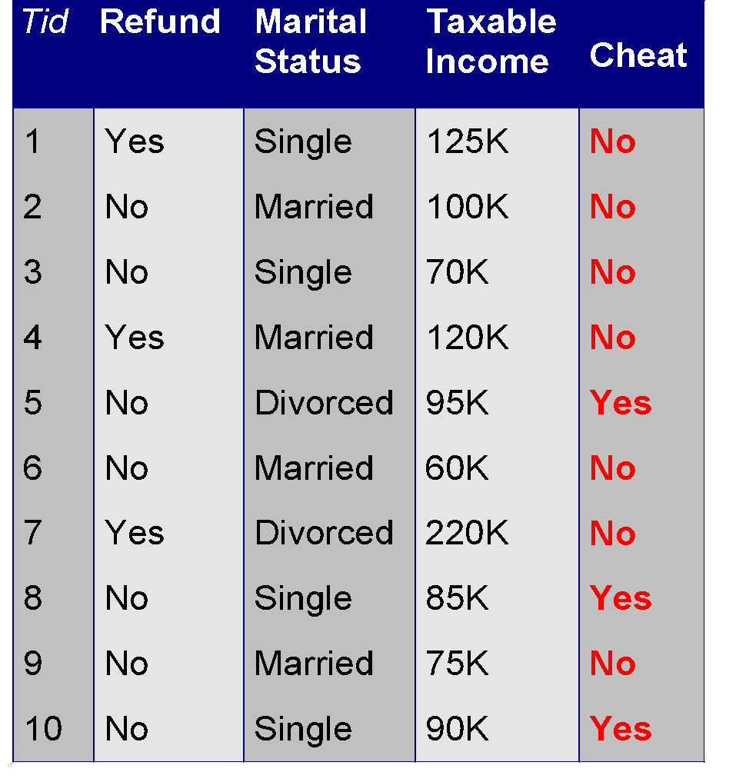
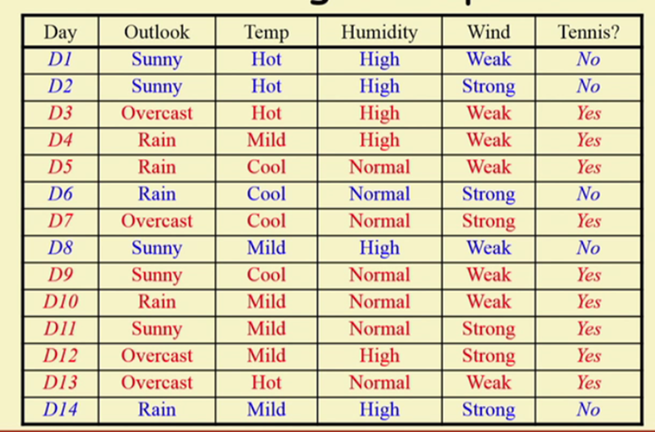
DATA SETS

Slide 21
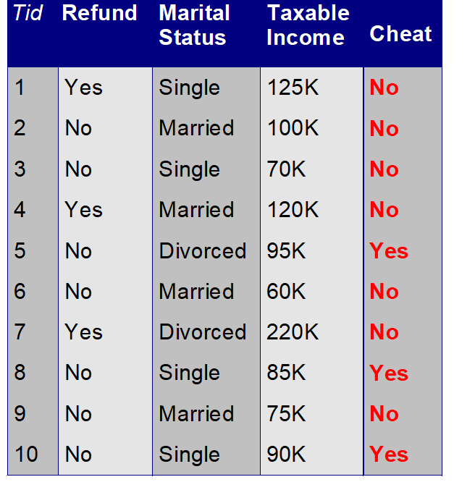
Steps for measuring the Impurity
Categorical
Categorical
Ratio
Class
Step-1: Class Distribution before and after the Split for each node as a probability measure P(i|t)
Nominal
Binary Attribute:
Refund
No
Yes
Yes | 3
No | 4
Yes | 0
No | 3
Note: P(i|t): Denotes the fractions of record belonging to class “i” at a given node “t”

Slide 22

Marital Status
Divorced
Single
Married
Yes | 2
No | 2
Yes | 0
No | 4
Yes | 1
No | 1
Taxable Income
Taxable Income
> 80K
<70K
>100k
<80K
{70K,100k}
Yes | 0
No | 3
Yes | 3
No | 4
Yes
No
Yes
No
Yes
No

Slide 23
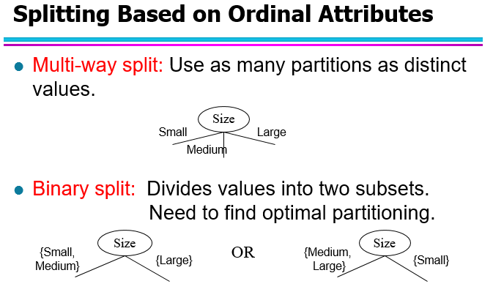
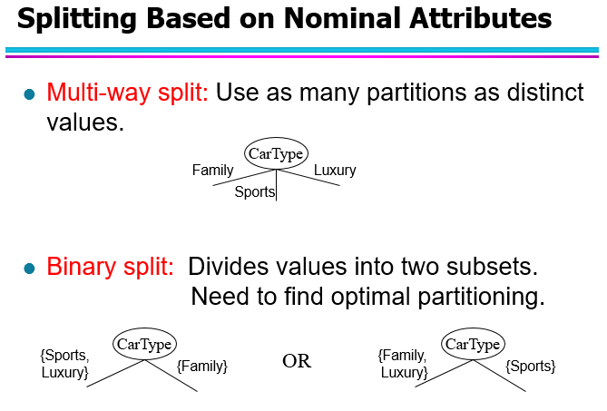
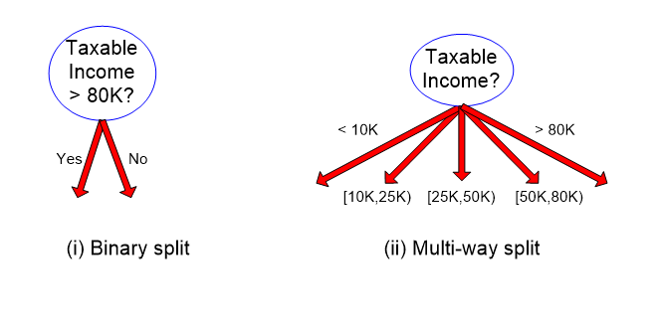
Splitting Continuous attribute in two ways

Slide 24
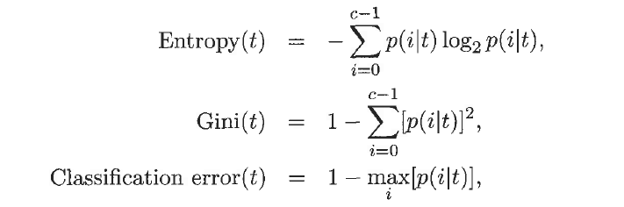
Steps for measuring the Impurity
Step-2: Calculate the Gini(t),Entropy(t) and Classification error(t) for each node
Where c: No of classes
Refund
Binary Attribute:
No
Yes
Yes | 3
No | 4
Yes | 0
No | 3
N1
N2

Slide 25




Parent Node(Refund)
Yes | 3
No | 7
Gini
Before Splitting at Parent Node
 | N1(Yes) | N2(No)
Yes | 3 | 0
No | 4 | 3
For N1
For N2

Slide 26
Marital Status
Divorced
Single
Married
Yes | 2
No | 2
Yes | 0
No | 4
Yes | 1
No | 1
Taxable Income
Gini =0.5
Gini =0
Gini =0.5
> 80K
<80K
Yes | 0
No | 3
Yes | 3
No | 4
Gini =0
Gini =0.489

Slide 27
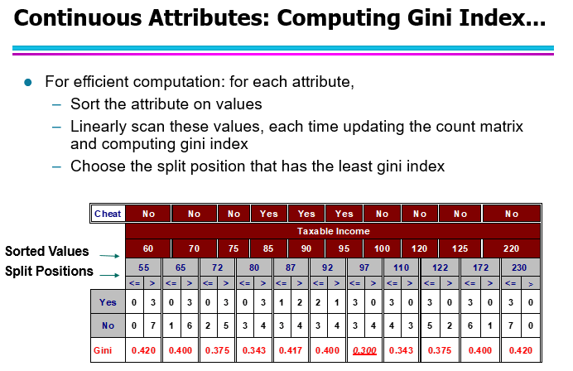

Slide 28
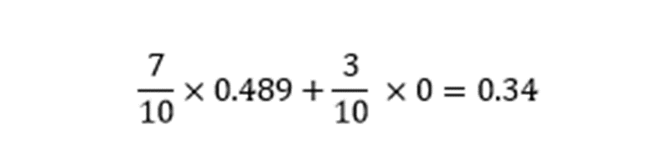

Step-3:To measure the( Information gain) OR Average Weighted Measure
Refund
Marital Status
Single, Divorced
Married
No
Yes
Yes | 3
No | 4
Yes | 0
No | 3
Yes | 3
No | 1
Yes | 0
No | 3
0.489
0
0.37
0

Slide 29

Step-3:To measure the( Information gain) OR Average Weighted Measure
Taxable Income
> 80K
<80K
Yes | 0
No | 3
Yes | 3
No | 4
Gini =0
Gini =0.489

Slide 30
Jai Sairam

Slide 31
DATA SET for Entropy based DT:

Slide 32


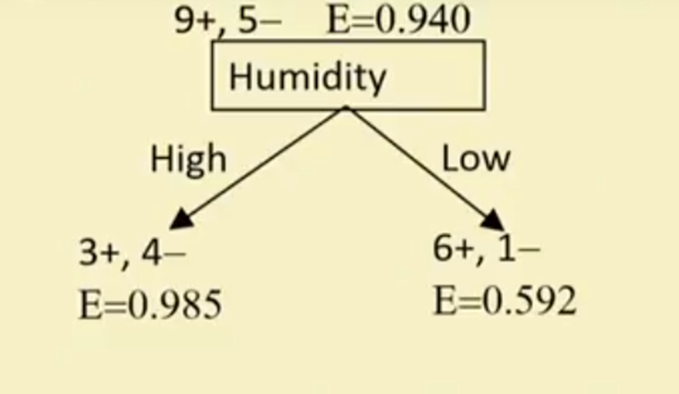


Entropy Based Calculation

Slide 33

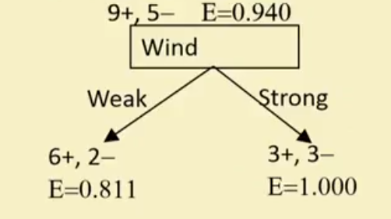


Slide 34
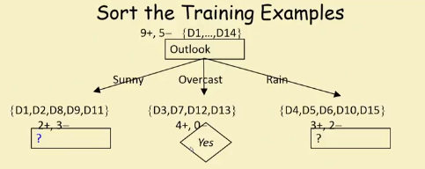
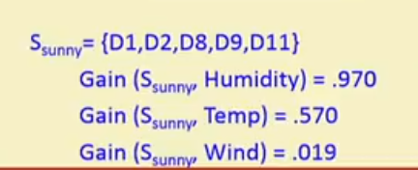

Slide 35
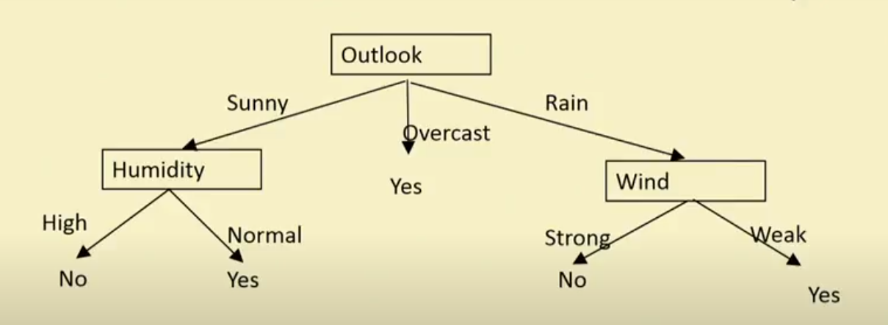

Slide 36
Jai Sairam

Slide 37
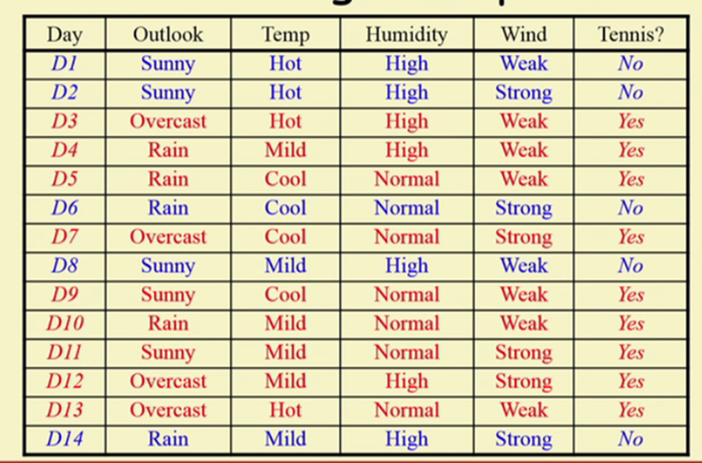
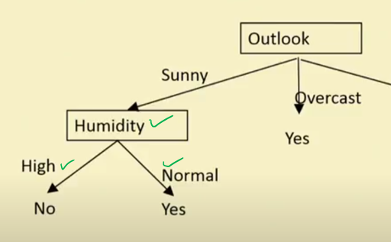

Slide 38
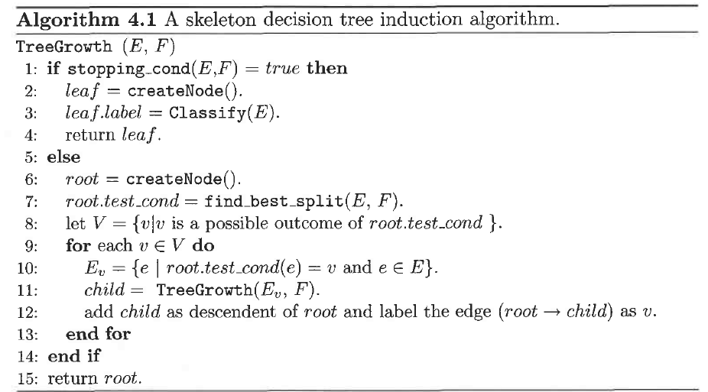
Decision Tree Algorithm and Overfitting

Slide 39
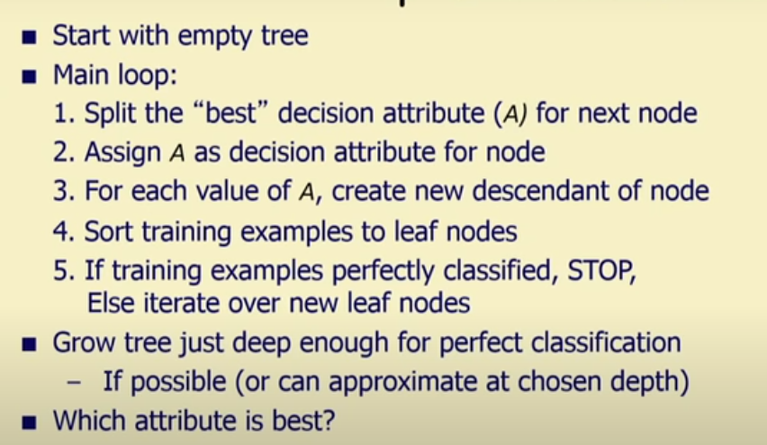
Decision Tree Algorithm

Slide 40
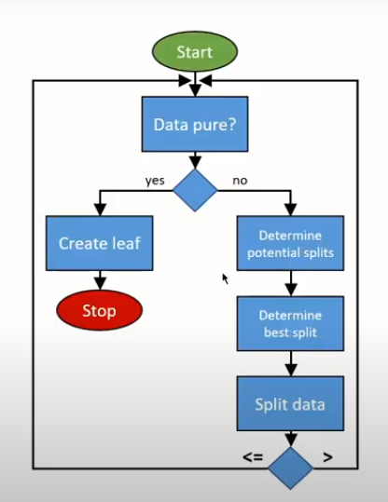
Flow chart for Decision Tree Algorithm

Slide 41
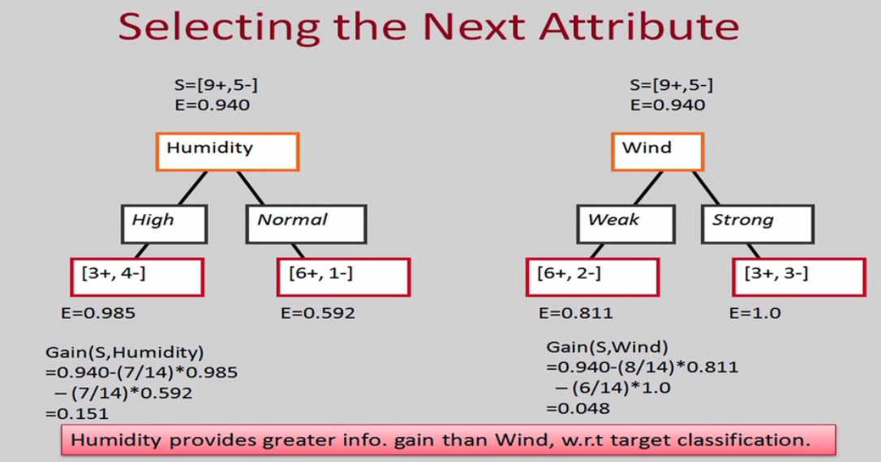

Slide 42
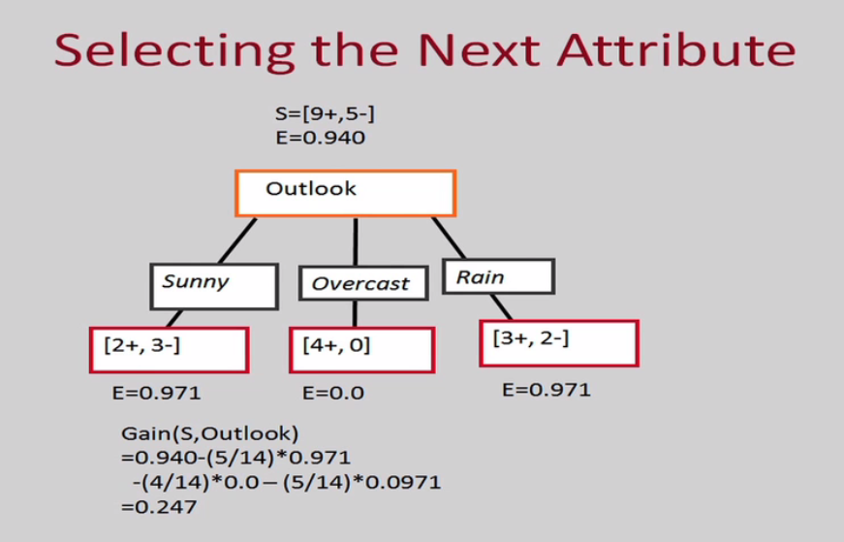

Slide 43
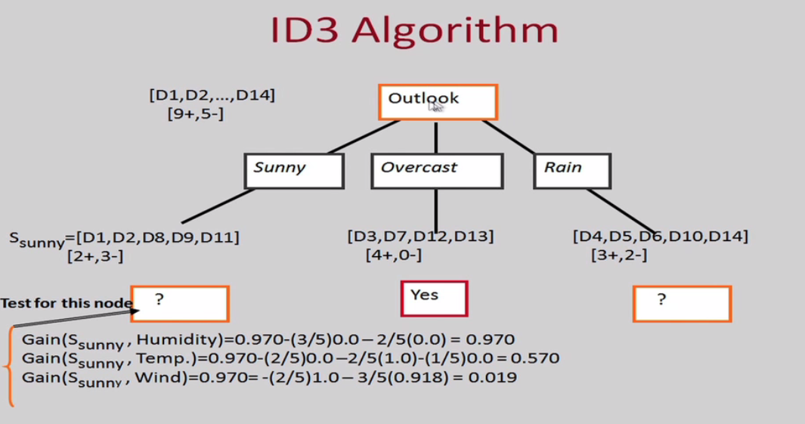

Slide 44
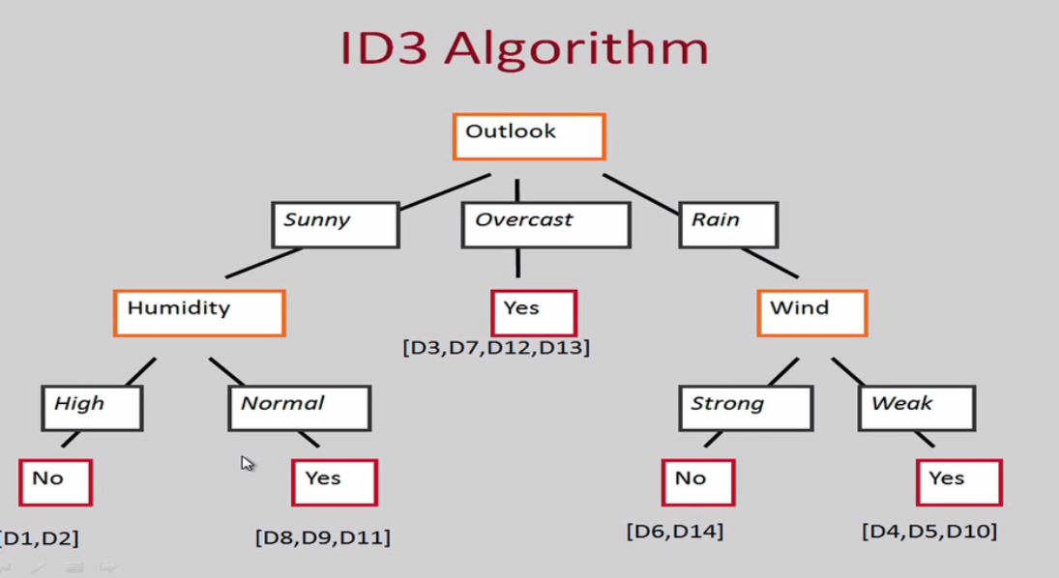

Slide 45
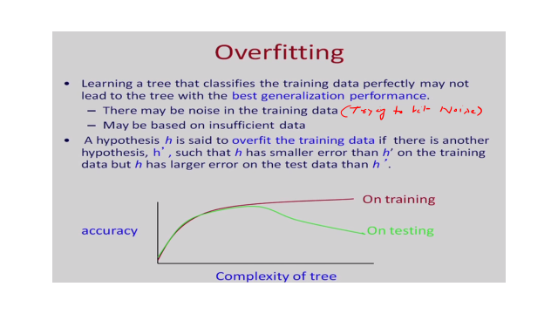

Slide 46
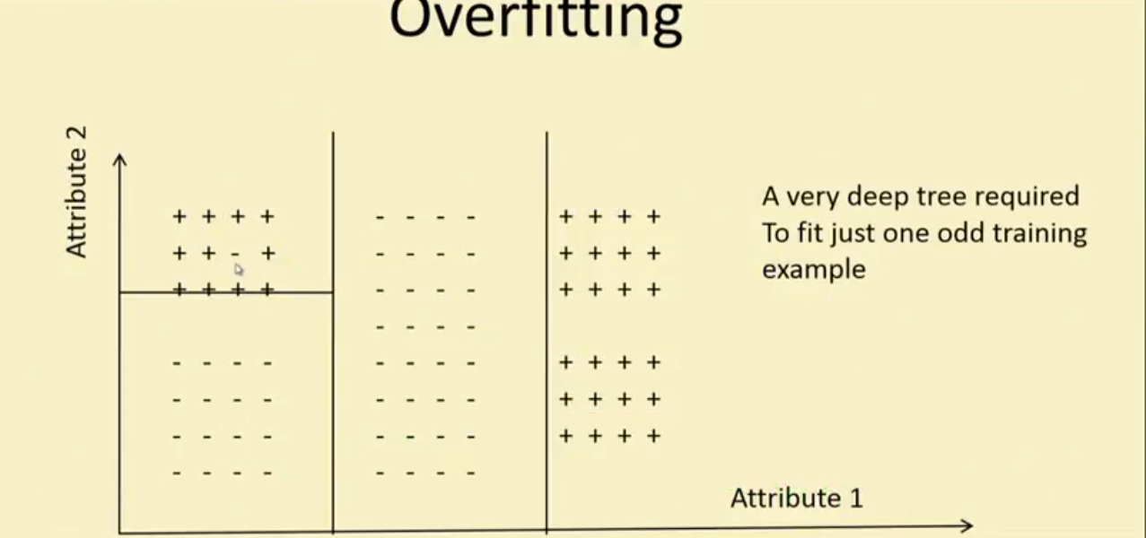

Slide 47
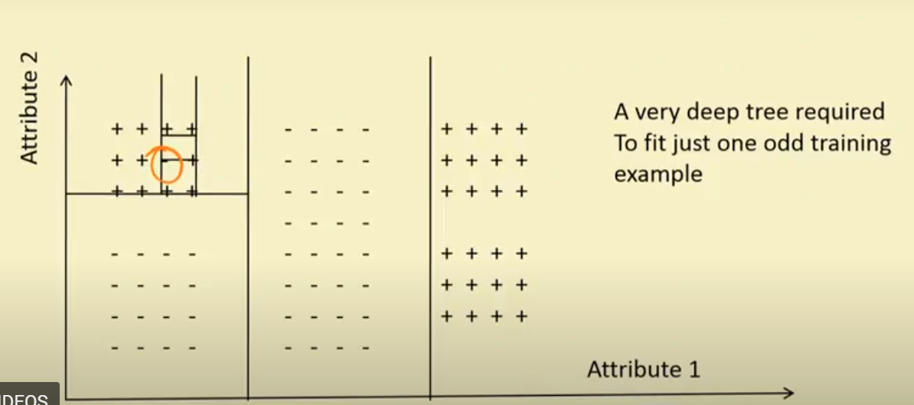

Slide 48
